Slide 1
Composites for Beginners
Tony Tao
2022.10.06
16.82x

Slide 2
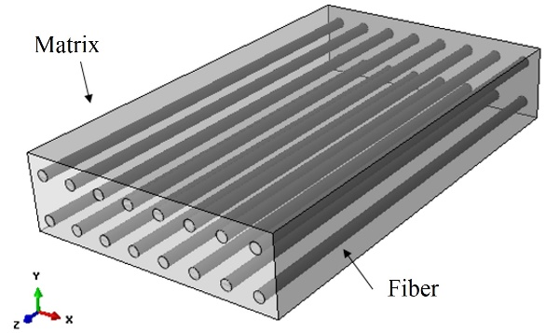
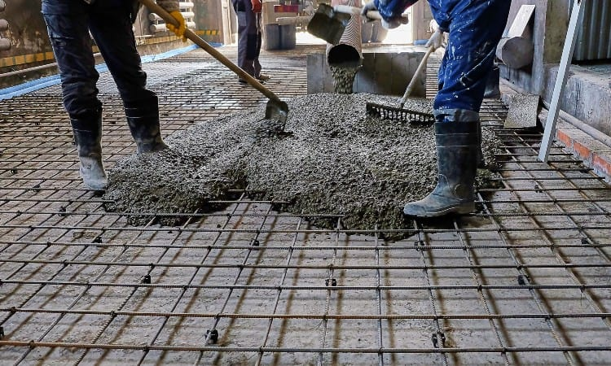
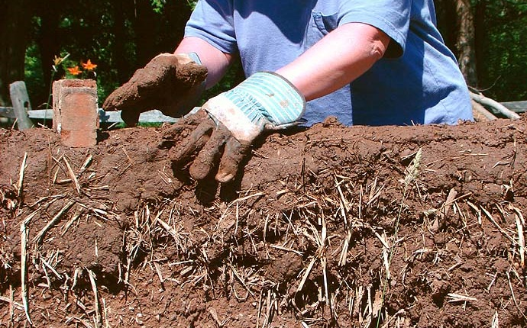
Composite Materials
Engineered composite material $≡$ a material consisting of two or more materials which - when combined - generates properties superior to the properties of the proportional average of the materials
Other examples:
Matrix (Epoxy or other thermoset plastic)
Fibers (Carbon fiber, Kevlar, fiberglass…)

Slide 3
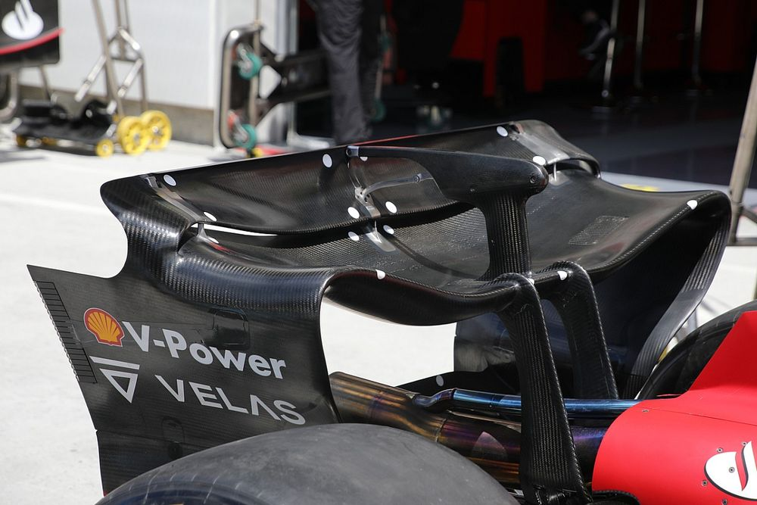
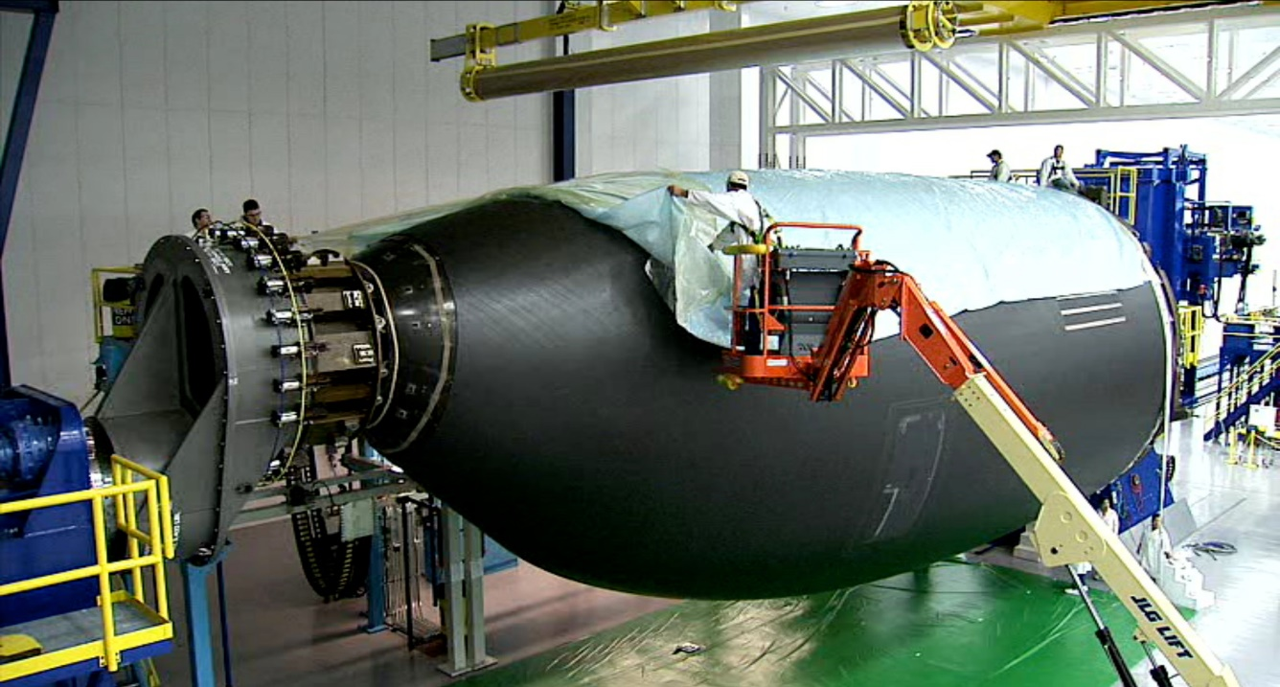
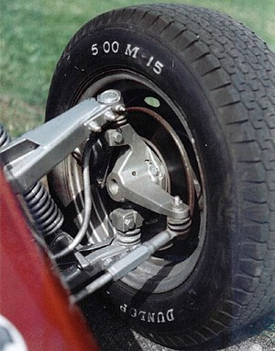
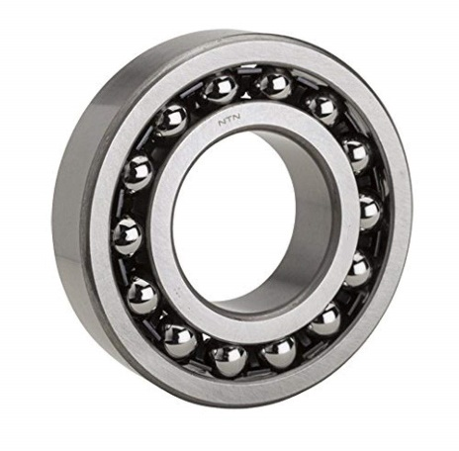
Advantages of Composites vs Metals
Composites
Suitability
Metals
Smooth, complex 3D curves
Non-isotropic tailoring
Cost-insensitive, weight-critical
Fastening
High temperatures
High surface-speed rubbing
Ball bearings
F1 rear wing
Aerospace primary structure
Car knuckle

Slide 4
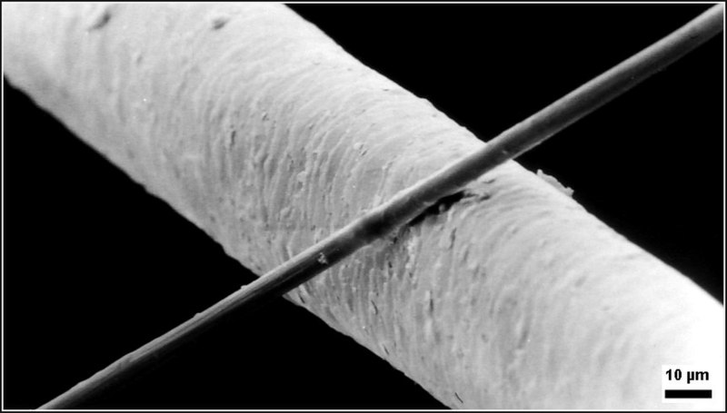
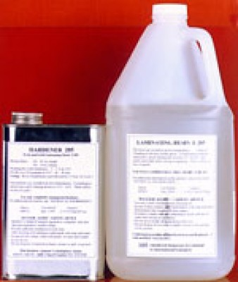
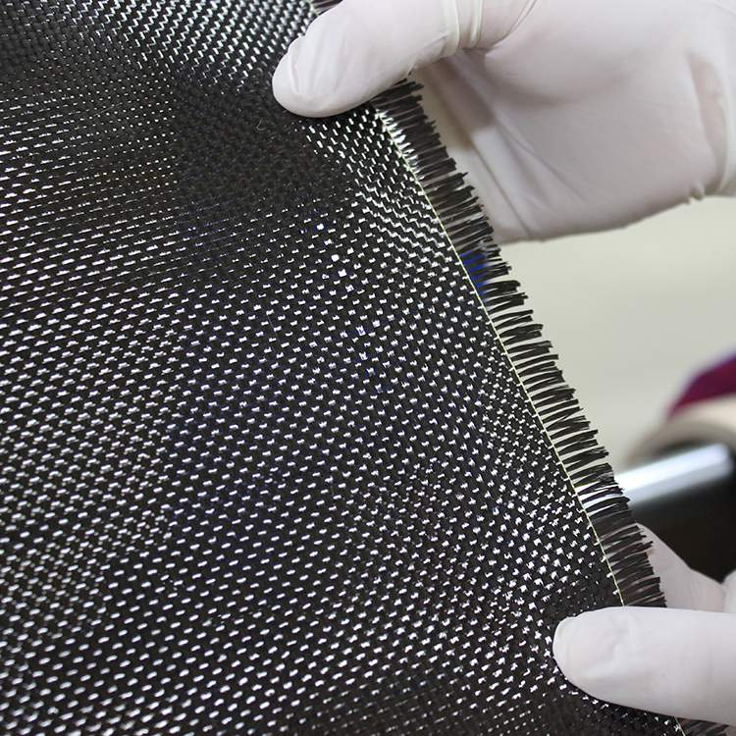
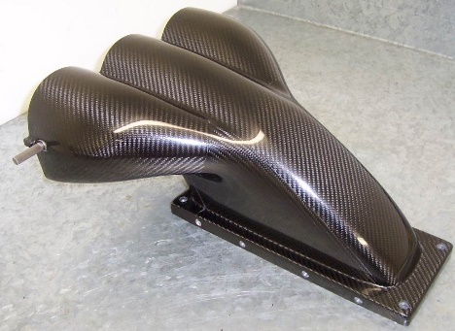
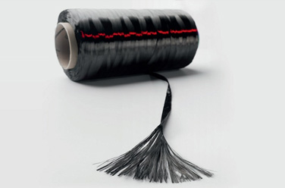
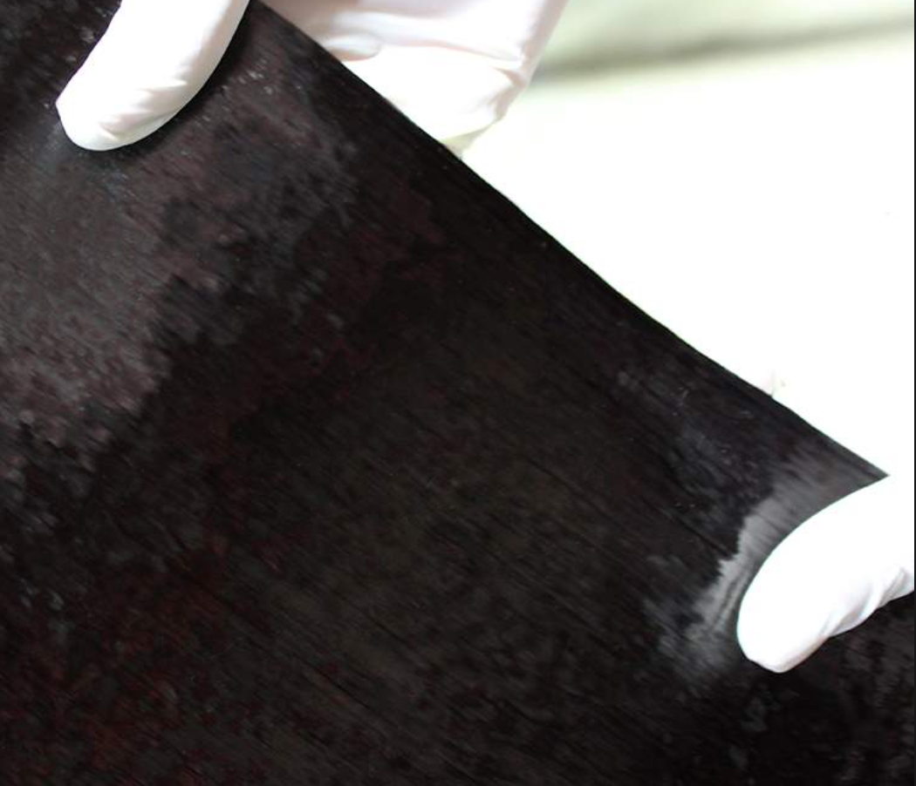
Fiber Organization
Human hair
50-30%
Fiber “strand”
“Tow” or “Yarn”
“Woven fabric”
50-70%
By mass
“Unidirectional fabric”

Slide 5
Fiber and Fabric Jargon
Fibers
UHM = “ultra high modulus” very stiff & brittle
HM = “high modulus” stiff & brittle
IM = “intermediate modulus” strongest
SM = “standard modulus” springy, cheapest
Tow
Fiber count/bundle
1000 = “1K”
3000 = “3K”
Woven Fabric
Weave
Weight
6 oz/yd²
200 gsm (g/m²)
Tow size
Bias
Thickness
Uni fabric
= woven fabric +…
Binding
Net ☹
Stitching ☹
Web 😐
P.S.: Cost is non-monotonic with weight!

Slide 6
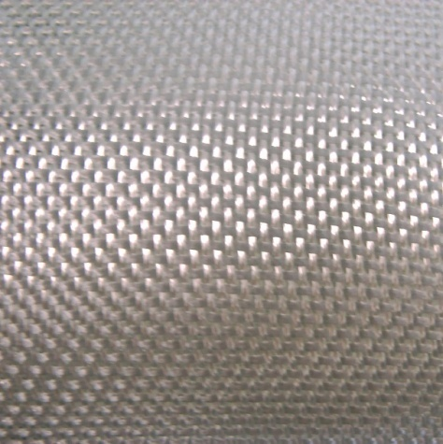
Fiberglass
Most compliant
Most economical
Many moduli available (E, S, etc)
Available in lightest weights
Commonly-available fabric weights:
0.6, 0.7, 1.4, etc etc
0.6, 0.7 considered “finishing glass”
Limiting single-layer dry weight: ~0.6 oz

Slide 7
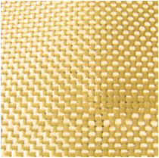
Kevlar (Aramid)
High tensile strength
Poor compressive strength
UV-sensitive
Annoying to work with (difficult to cut cleanly)
Commonly-available fabric weights:
1.0, 1.7, 5.0
Limiting single-layer dry weight: ~1.7 oz
Many UAV shells are made from Kevlar – why?
Protip: Heat prior to wet layup to remove moisture

Slide 8
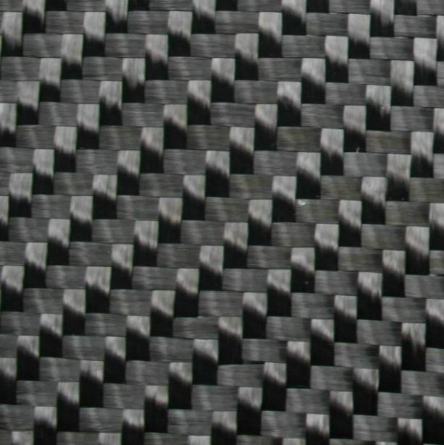
Carbon Fiber
High Modulus (both compressive and tensile)
High UTS
High cost
Can be brittle, depending on fiber selected
Commonly-available fabric weights:
2.4, 3.5, 5.7, 10.9
Limiting single-layer dry weight: ~2.5 oz

Slide 9
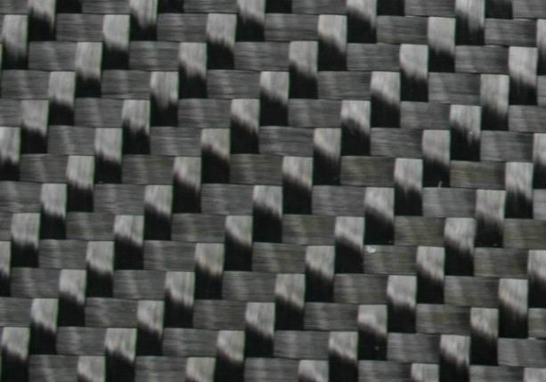
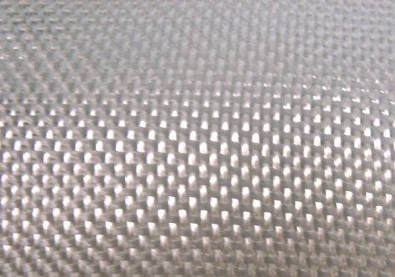
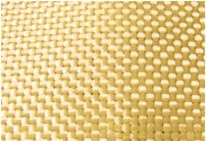
Common fiber material summary table
 | Carbon Fiber | Fiberglass | Aramid (Kevlar)
Tensile str | Excellent | Good | Excellent
Compression str | Excellent | Good | Terrible
Spring energy | Good | Excellent | Bad
RF penetration | Bad | Good | Good
Abrasion resist. | Bad | Bad | Good
Processing | Okay | Okay | Terrible
Price | High | Low | Med
Density | High | Low | Low

Slide 10
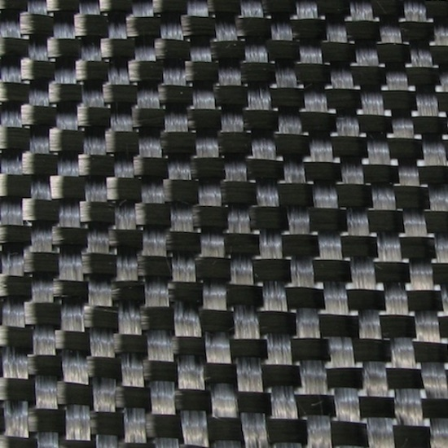
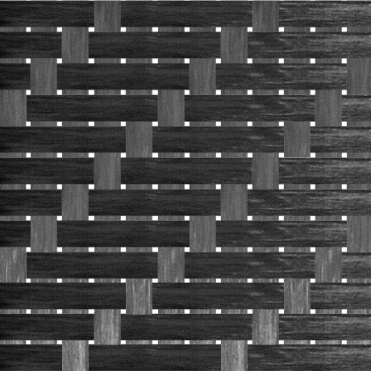
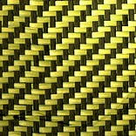
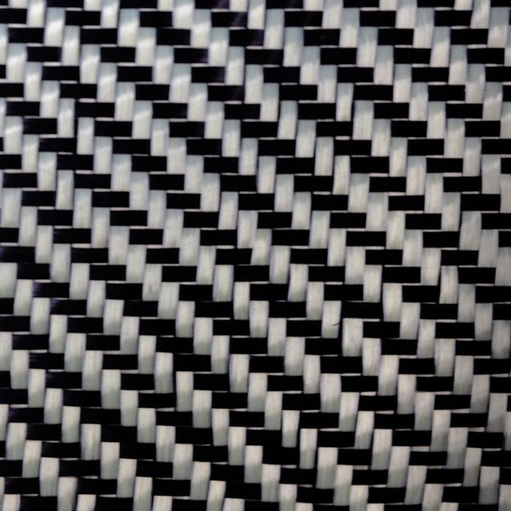
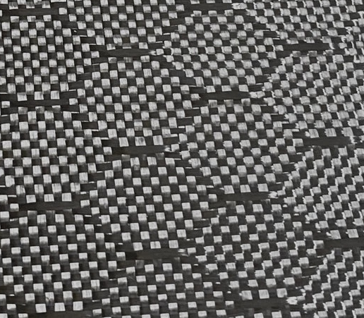
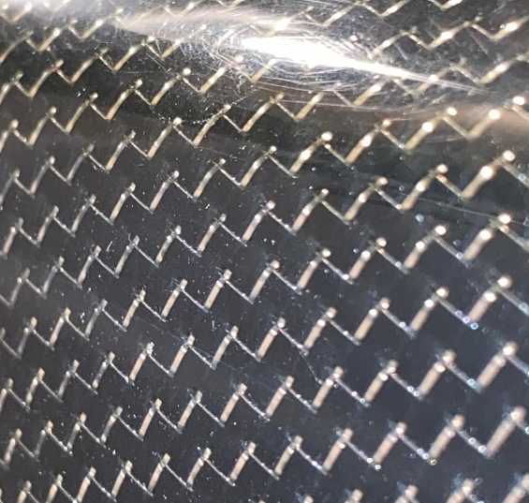
Weaves and Multi-Species Fabrics
Plain Weave
4HS Satin Weave
Carbon-Kevlar hybrid
Easiest to work with for flat shapes
Easiest to handle
Conforms to holes, 3D shapes
Difficult to handle
Twill Weave
Honeycomb Weave
Carbon-metal hybrid
Good at conforming to 3D shapes
Somewhat difficult to handle
Looks neat ???

Slide 11

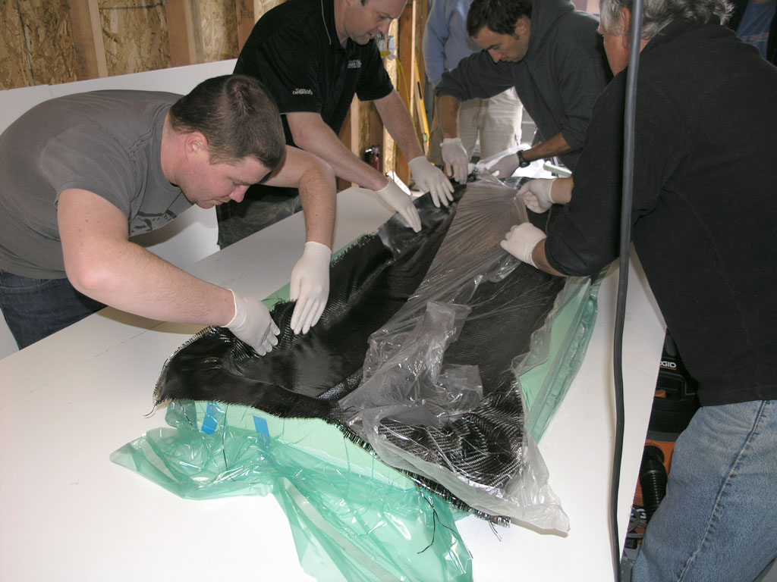
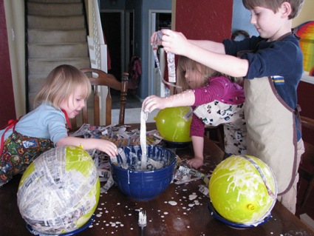
Composite Manufacturing Process
“Carbon Fiber Reinforced Polymer (…) fabrication has been described as a black art. What is it, really?”
http://www.mmsonline.com/articles/getting-to-know-black-aluminum
Answer:
≈

Slide 12
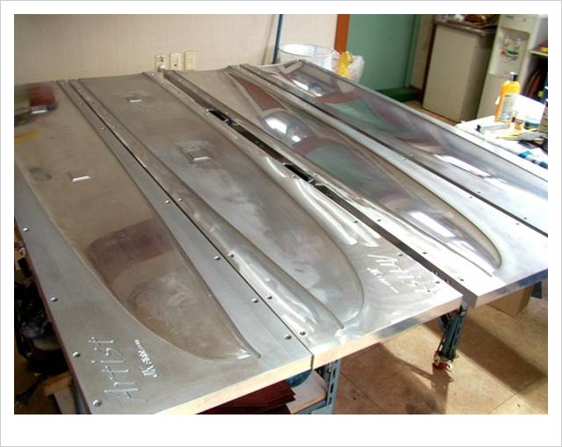
Molds
Molds may be metal, composite, plastic, whatever
May be solid or compliant (silicone, etc)
Release agents must be used for most molds
Molds are often painted before layup; paint will stay with composite part ☺

Slide 13
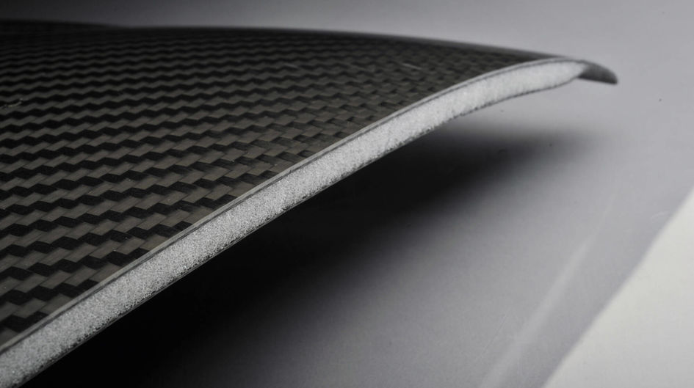
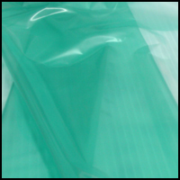
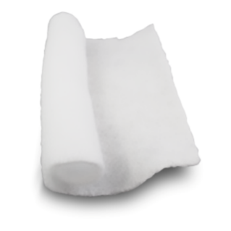
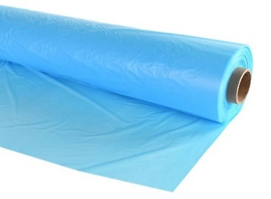
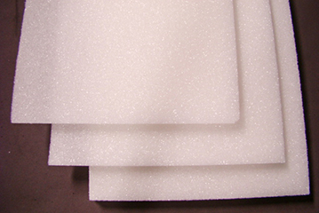

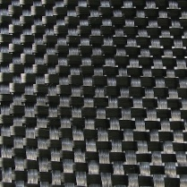
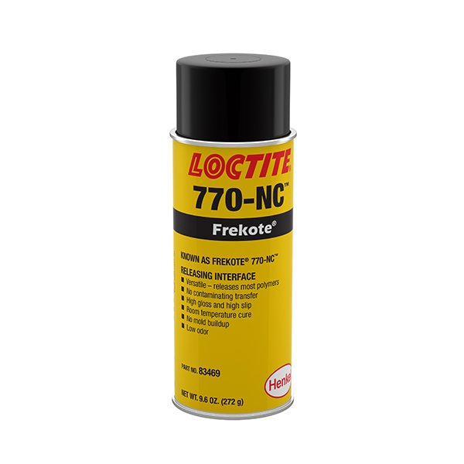
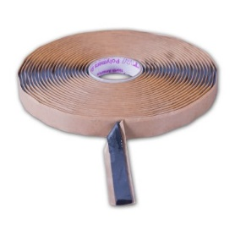
Lay-up Process Basics
Breather
Bagging film
Porous release film
(or peel ply)
Foam core
Fabric (wet)
Epoxy
Butyl tape
Mold
Release agent (spray, wipe, or wax)

Slide 14
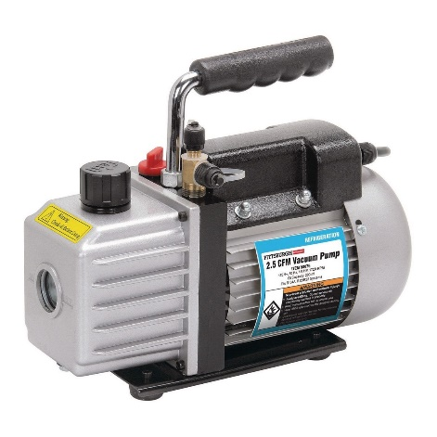
Lay-up Process Basics
Before Compression:
Under Vacuum Compression:
Purpose of vacuum:
Remove air bubbles
Reduce inter-fiber distance
Air bubbles
Carbon fibers
Epoxy
Mold
Mold
Work time for epoxy ~a few hours
Cure time ~18-24 hours before debagging (faster with heat, but plastics and mold may not survive)
Debagging can break parts, be careful

Slide 15
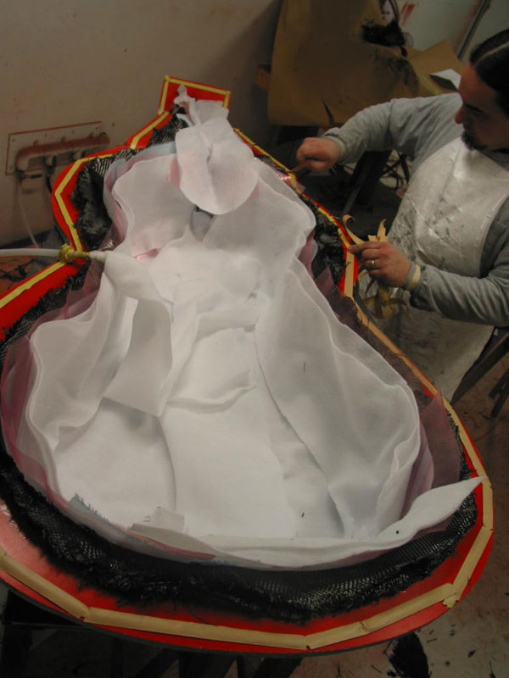
Technique: Wet lay-ups
Fibers are wetted with epoxy
Bagged onto mold while wet (with excess)
Excess epoxy is absorbed or bled out
(+) Minimal equipment
(+) Can achieve very low weight
(-) …but is less reliable at it
(-) Fairly labor-intensive

Slide 16
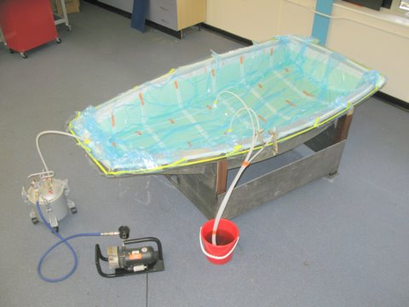
Technique: Resin Infusion
Fibers are placed in mold dry
Vacuum-bagged while dry
Resin from reservoir is pulled in by vacuum pressure
(+) Less labor than wet layup
(-) Epoxy viscosity critical
(-) More wasteful (epoxy, plumbing)
(-) Can’t achieve as low a weight as wet layup

Slide 17
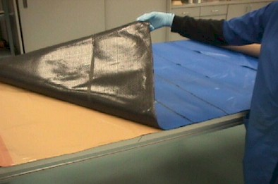
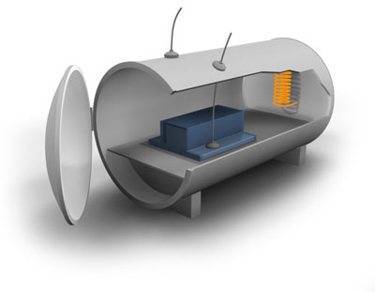
Technique: Pre-preg
Fibers pre-impregnated with high temperature epoxy
Fabrics are assembled, bagged, and cured under pressure + heat
(+) Cleanest
(+) Maximum strength
High pressure fiber packing, better microstructure of impregnated epoxy
(+) Low labor cost
(-) Very high equipment cost (freezer, autoclave)
(-) Prepreg has expiration date due to pre-mix

Slide 18

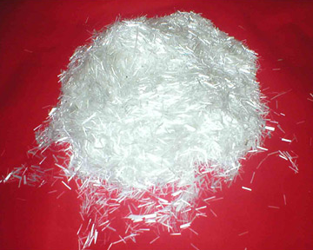
Fillers
Used to change properties of epoxy (viscoelasticity, density, strength)
Can lighten bulky regions
Microballoons (don’t breathe these)
Can strengthen
Colloidal silica (don’t breathe these either)
Chopped fiber (nope, not these guys either)

Slide 19
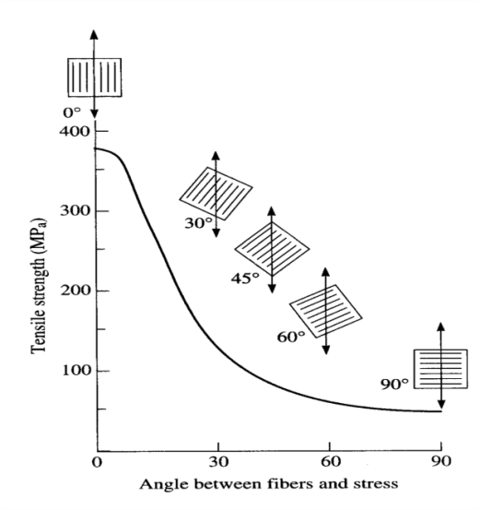
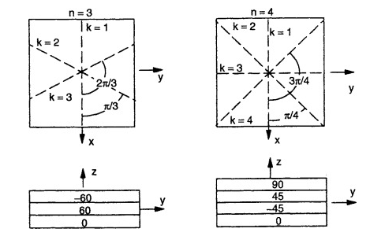
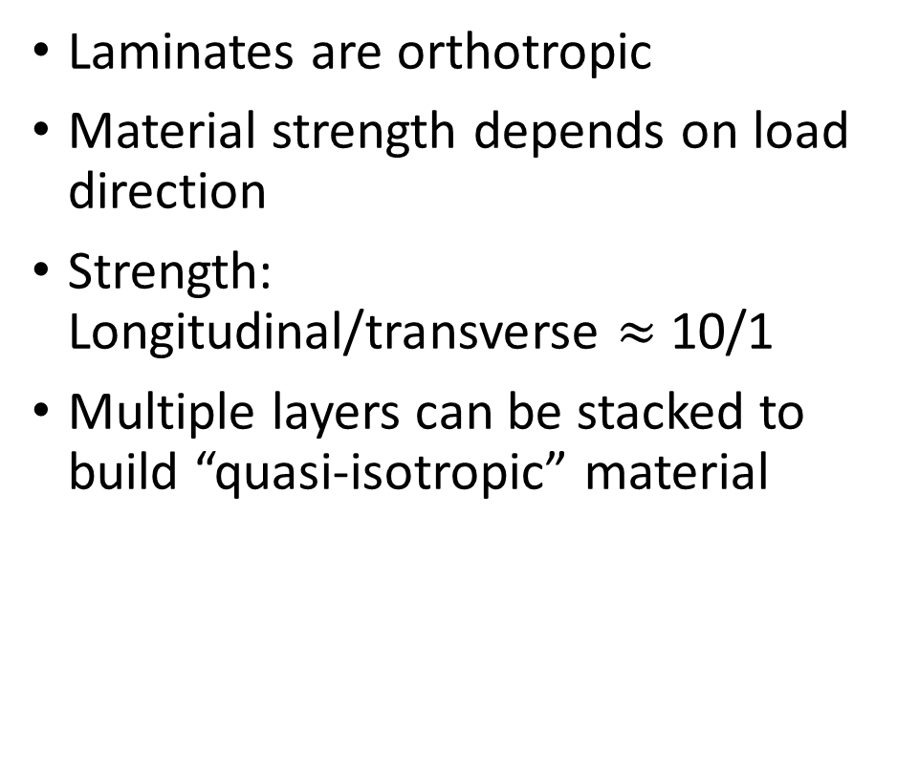
Mass and Strength Estimation
Laminates are orthotropic
Material strength depends on load direction
Strength: Longitudinal/transverse $≈$ 10/1
Multiple layers can be stacked to build “quasi-isotropic” material
Longitudinal
Transverse

Slide 20

Typical Design First-Estimates
Euler beam bending
Unidirectional modulus & strength
90°
Spar: 0°
D-tube: 45°-45°
0°
Closed section torsion
45-45 laminate direction
Beware of out-of-plane buckling constraint

